Slide 1
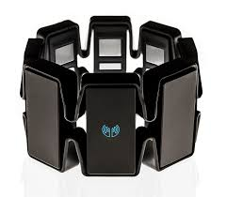
Myo Armband Controlled Gaming for Task Specific Stroke Rehabilitation

Slide 2
Myo Armband
EMG Signals
8 Channel EMG pods
Recognizes 5 types of hand gestures (Fist, Finger Spread, Wave left, Wave right, Double tap)
9 axis IMU data
Accelerometer
Gyroscope
Magnetometer

Slide 3
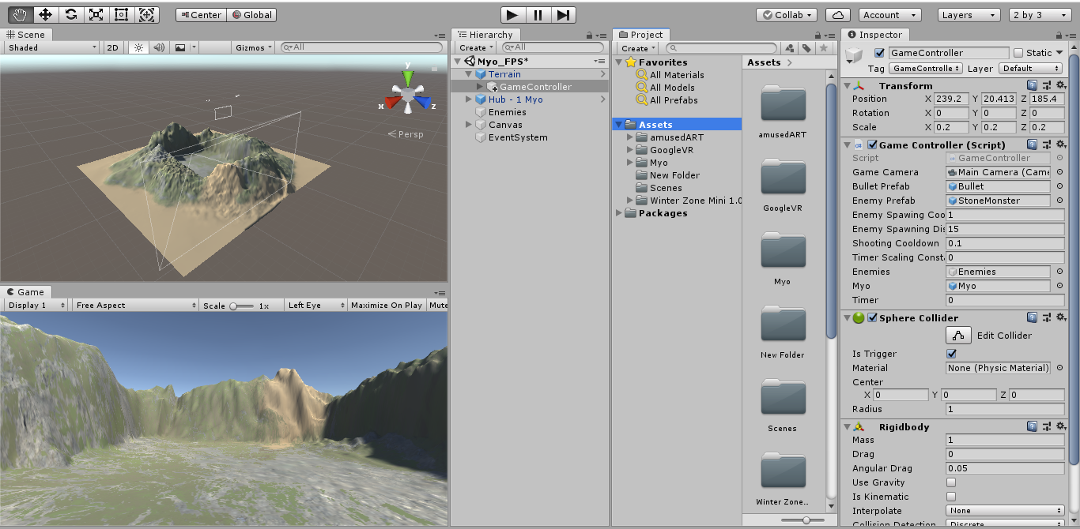
Unity Game Engine

Slide 4
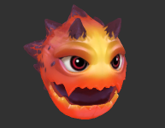
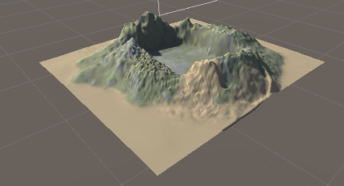

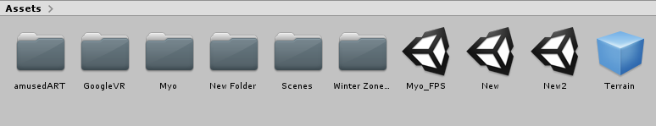
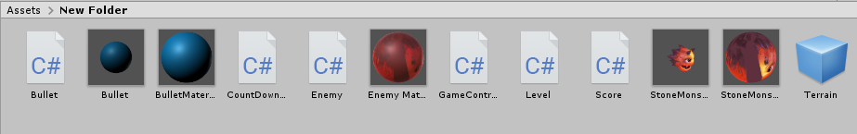
Assets
Consists of physical 3D models
Scripts (Classes – functions and variables)
Game Scenes
Prefabs (Pre-defined unity objects)
Enemy Prefab

Slide 5
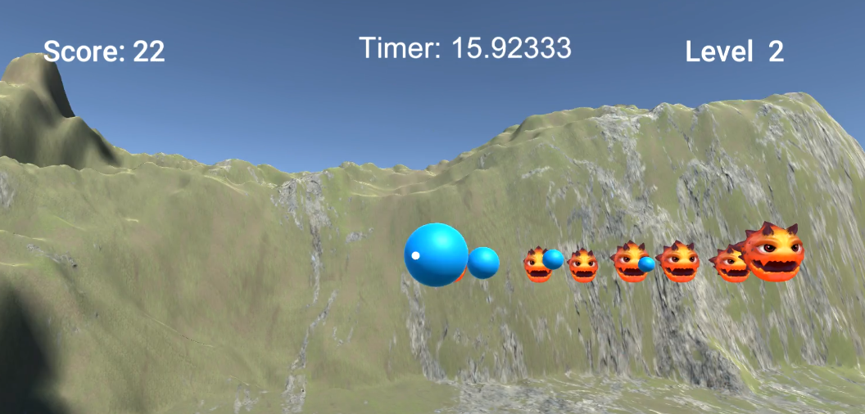
Gaming Interface

Slide 6
MYO + Unity
Importing MYO Unity scene from SDK
Consists of MYO libraries like libmyo, Myo, EventTypes, etc.
Prefabs of Myo hub object
Connects the myo armband with the unity game engine
Scripts consisting functions like quaternion, vector, pose, orientation, etc.

Slide 7
Game objects
Terrain
Fixed game object
Enemies
Spawned after a certain time
Bullets
Spawned after you aim at enemies and make a fist gesture
Myo object (empty game object)
Game object of myo arm band

Slide 8
C# Scripts
Game Controller
Bullet
Enemies
Score
Level
Timer

Slide 9
Game Controller- Main C# script
Accessing all the other scripts to attain certain functionality
Syntax: (Class) (Object Variable)= GameObject.GetComponent<script attached to the object>();

Slide 10
Game Controller- Main C# script
Spawning the enemies
Instantiating the enemy prefab
Setting rate of spawning
Limiting the area of spawning
Moving the enemy object towards the player or camera

Slide 11
Game Controller- Main C# script
Spawning Bullet object
Spawn only when ray-cast hits the desired target i.e. enemy tag
And only when player perform Fist gesture
It is spawned at origin of the camera

Slide 12
Game Controller- Main C# script
Using MYO game-object
To use myo game-object, need to call myo script ( i.e. ThalmicMyo ) to manipulate the object
Align the orientation of the myo armband with XYZ frame of the game using wave right gesture
Using rotation function of the object to make Yaw motion. (used to aim at enemy)

Slide 13
Other C# script
Bullet
Moving the bullet towards the enemy to destroy the enemy object
Killing the Bullet game-object after certain time even if it doesn’t hit enemy
Enemy
Defines the spawning position of the enemy prefab
Score
Increment score as the target/enemy is destroyed
Level
Increment the difficulty level of the game
Timer
A count down timer to change the game level

Slide 14
Link to the Video
https://youtu.be/yfPjKI0ypEw

Slide 15
Thank You

